Slide 1
Module 1:
Overview
Foundations of ML for Security
ML for Cybersecurity
November 10, 2020

Slide 2
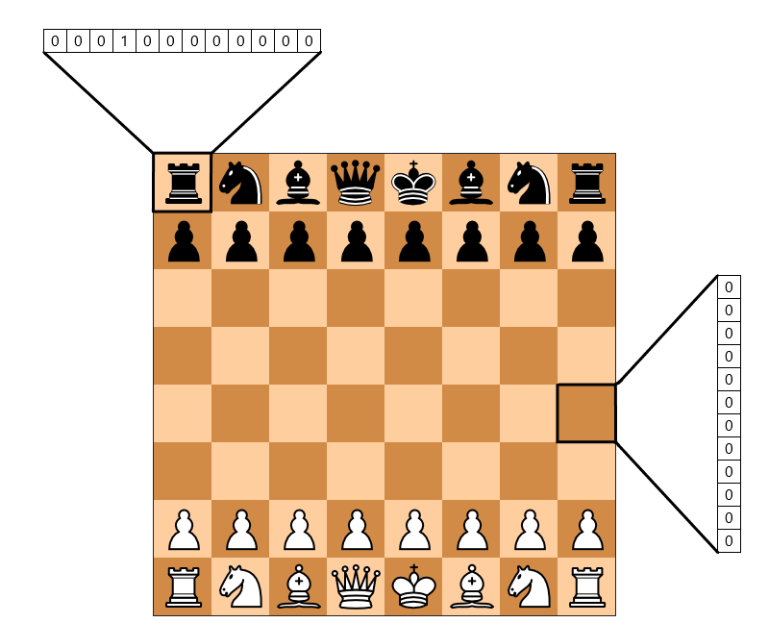



What is Machine Learning?
Automatic discovery of predictive rules from history

Slide 3
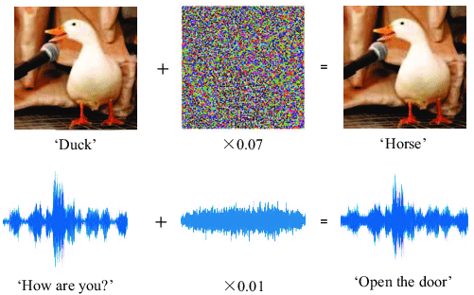

Machine Learning as a Tool for Cyber Security
Attacks – Learning – Defense
Machine learning for security
Security against attacks that exploit machine learning

Slide 4

Definition of Machine learning
Arthur Samuel, 1952:
Machine learning is the ability to learn without being explicitly programmed

Slide 5
A Brief History
1950: Alan Turing created the world-famous Turing Test — “The Imitation Game”
1952: Arthur Samuel coined the phrase “machine learning”, and create a computer program that improves checkers game
1956: The Dartmouth workshop started AI as a field (John McCarthy, Marvin Minsky, Nathaniel Rochester, Claude Shannon …)
1958: Frank Rosenblatt designed the first artificial neural network
1986: Geoffrey Hinton introduced backpropagation which enabled monumental leaps in ANNs
1995: Cortes and Vapnik “standardized” support vector machines
1997: Deep Blue beats a chess champion
1999: Computer-aided diagnosis catches more cancers (CAD Prototype at UChicago)
2009: Launch of ImageNet
2011: Watson competed on Jeopardy! and won against Ken Jennings and Brad Rutter
2012: AlexNet won the ImageNet competition, which led to the use of GPUs and Convolutional Neural Networks in machine learning
2016: AlphaGo defeated the human champion Lee Sedol in a best-of-five duel match
…
Now: AI dominates Silicon Valley and becomes pervasive
https://cloud.withgoogle.com/build/data-analytics/explore-history-machine-learning/

Slide 6
Related disciplines
information theory
statistics
philosophy
causality
Machine Learning
algorithms
optimization
neural-informatics

Slide 7
Module Overview

Slide 8
Machine Learning for Cyber Security
Module 1: “Modeling”
Module 2: “Representation”
Foundations of ML and Data Science for Cybersecurity
Data-Driven Network and
Computer Security
Module 3: “Environment”
Module 4: “Constraint”
Machine Learning in the Presence of Adversaries
Ethics, Fairness, Responsibility,
and Transparency in
Data-Driven Cybersecurity
Notes:
A module focused on machine learning fundamentals, with applications to security. Introduction to the data science pipeline, and teach fundamental building blocks, from data ingestion and feature engineering to machine learning model selection.

Slide 9

Foundations of “Modeling”
Machine learning pipeline
The statistical learning framework
Generative & discriminative modeling
Basic supervised learning models
Logistic regression
Naïve Bayes
Neural nets
Unsupervised learning
Dimensionality reduction
Clustering
Credit @NOELIAGOROD

Slide 10
Learning Objective

Slide 11
After participating in this module, you will
understand basic machine learning ideas & concepts
learn to use statistical tools to analyze machine learning models
understanding the role of ML in data-driven cybersecurity
have some experience applying machine learning algorithms on cybersecurity applications

